Slide 1
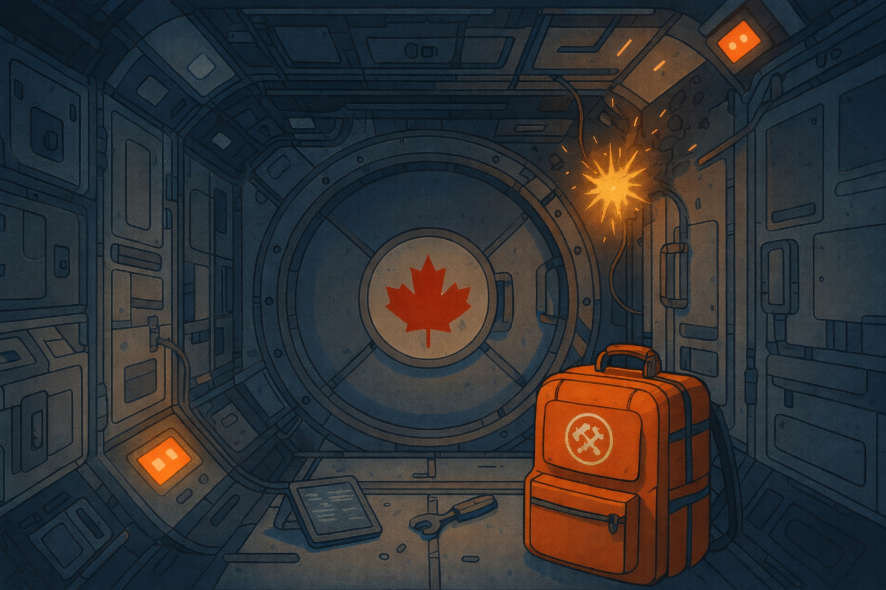
PROJECT CONTROL DOCUMENT
AURORA
VISUAL DESIGN
GUIDE
A working system for documents, props, screens and promotional assets
WORKING STANDARD • 2026

Slide 2

FOUNDATION
The identity balances authority and danger
CREDIBLE
Official enough to feel issued by a real station or agency.
TACTILE
Props should look handled, printed, scanned, stamped or repaired.
CORE IMPRESSION
Orange signals action, danger and anomalies—never decoration alone.
Canadian institutional
retro-futurism under pressure
URGENT
SPACE STATION AURORA | WORKING VISUAL SYSTEM
02

Slide 3

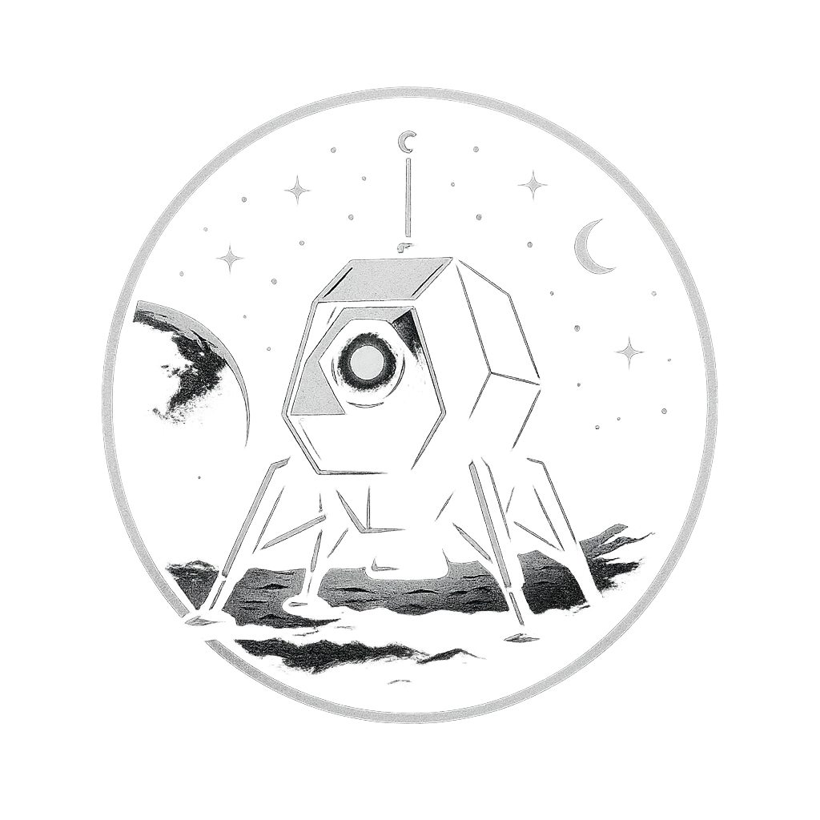

FOUNDATION
A clear hierarchy keeps the fictional world readable
PRIMARY MARK
PARENT AGENCY
SYSTEM MARK
EVIDENCE MARKS
Station Aurora
MAPLE
H.A.R.O.L.D.
In-world entities
Adventure title, crew assets, station documents
Official briefings, IDs and mission-control material
Terminal, diagnostics and automated instructions
Bank, betting, retail and antagonist documents
Rule: only Station Aurora and MAPLE should behave like master brands. Other marks are story evidence.
SPACE STATION AURORA | WORKING VISUAL SYSTEM
03

Slide 4
FOUNDATION
Two colours carry the core identity
AURORA NAVY
EMERGENCY ORANGE
#16253C
#A84420
Authority • structure • night systems
Action • warning • evidence anomaly
RECOMMENDED SUPPORTING NEUTRALS
WHITE
COOL PAPER
DATA BLUE
ALERT TINT
INK
SPACE STATION AURORA | WORKING VISUAL SYSTEM
04

Slide 5
FOUNDATION
Typography separates station voice from evidence
DISPLAY
ORBITRON EXTRABOLD
Station titles, key labels and dramatic system states
SYSTEM
ORBITRON
Navigation, short instructions, codes and crew-card labels
OPERATIONAL
Aptos
Briefings, records and longer reading
DATA
Aptos Mono 2912 / ORBIT
Receipts, timestamps, keypad inputs and diagnostics
RESERVED: Dreaming Outloud Pro for rare handwriting. Choose one E.V.I.L. typeface before final production.
SPACE STATION AURORA | WORKING VISUAL SYSTEM
05

Slide 6
MARKS
Station Aurora owns the page
USE
• One clear primary mark per asset
• Keep generous open space around the patch
• Use MAPLE as issuer or parent agency
AVOID
• Treating H.A.R.O.L.D. or E.V.I.L. as co-equal brands
• Placing the patch on busy imagery without contrast
PRIMARY PROJECT MARK
• Enlarging the current 102 px patch for large-format print
Production gap: create a vector or high-resolution master of the Station Aurora patch.
SPACE STATION AURORA | WORKING VISUAL SYSTEM
06

Slide 7
IMAGERY
Illustration should feel retro-futurist, not generic sci-fi
KEEP
• Navy machinery with warm orange failure points
• Visible wear, paper texture and practical equipment
• Canadian cues used as world-building, not decoration
AVOID
• Neon cyberpunk palettes
• Photoreal and cartoon styles mixed in one asset
SPACE STATION AURORA | WORKING VISUAL SYSTEM
07

Slide 8
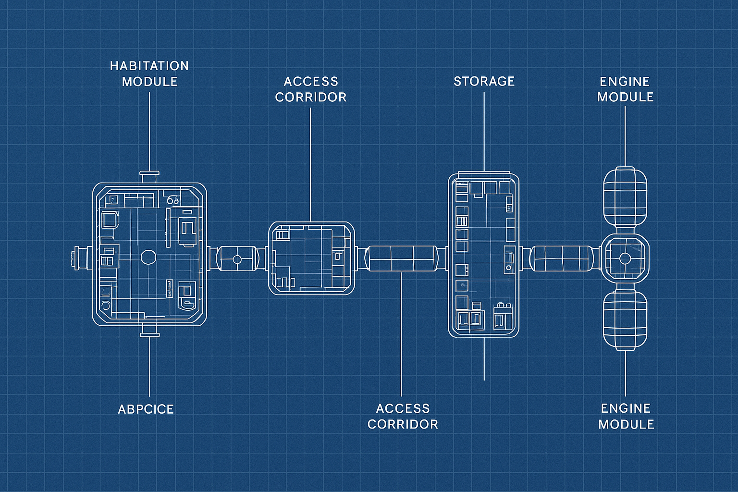
IMAGERY
Icons behave like station instrumentation
RULES
• Use a single navy icon family for modules and controls
• Keep icons flat, legible and printable in one colour
• Reserve orange for the active fault or required action
H.A.R.O.L.D. is a character mark; module icons should remain simpler than the mascot.
SPACE STATION AURORA | WORKING VISUAL SYSTEM
08

Slide 9



APPLICATIONS
Props should look issued, handled and believable
RETAIL
BETTING
BANK
CORPORATE
Thermal-paper tone, mono data, imperfect alignment
Distinct identities; restrained document layouts
Conservative typography and official spacing
Cold, controlled and intentionally separate from Aurora
Believability comes from hierarchy, spacing, dates, signatures and material—not from adding more decoration.
SPACE STATION AURORA | WORKING VISUAL SYSTEM
09

Slide 10
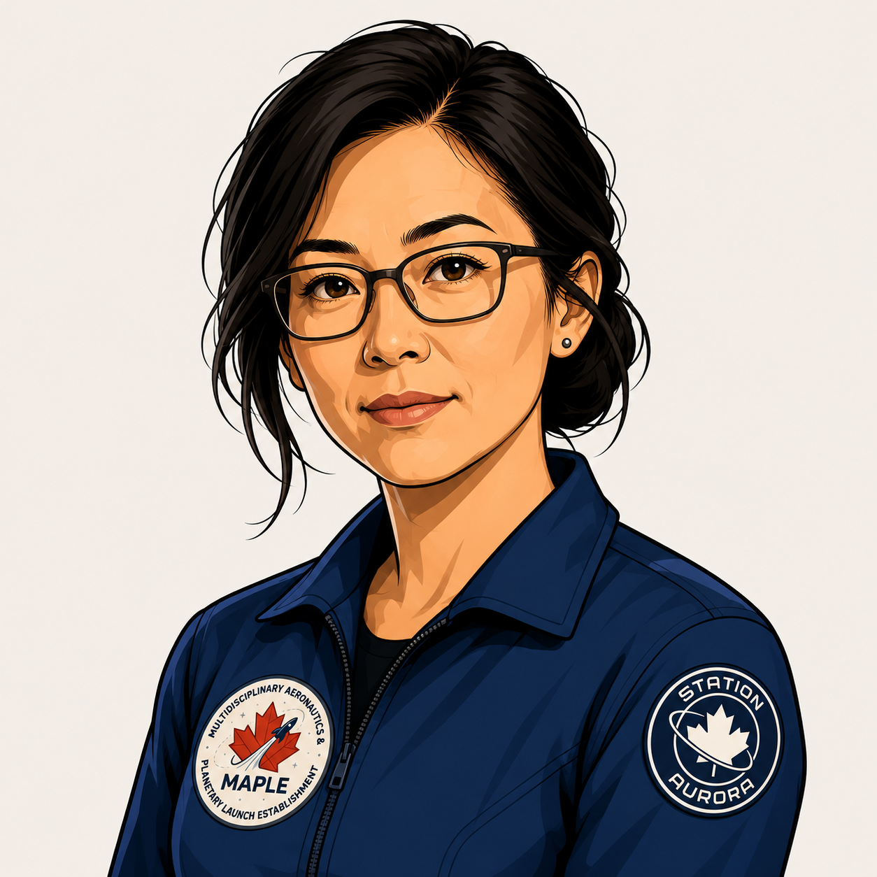

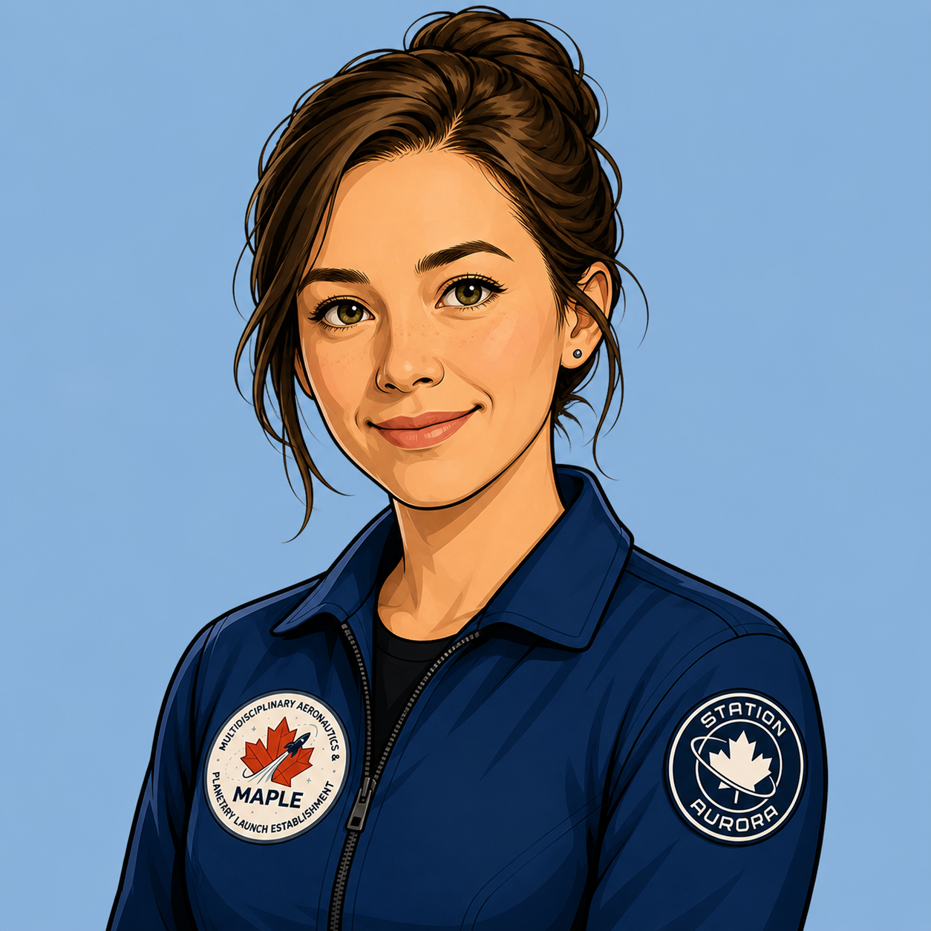
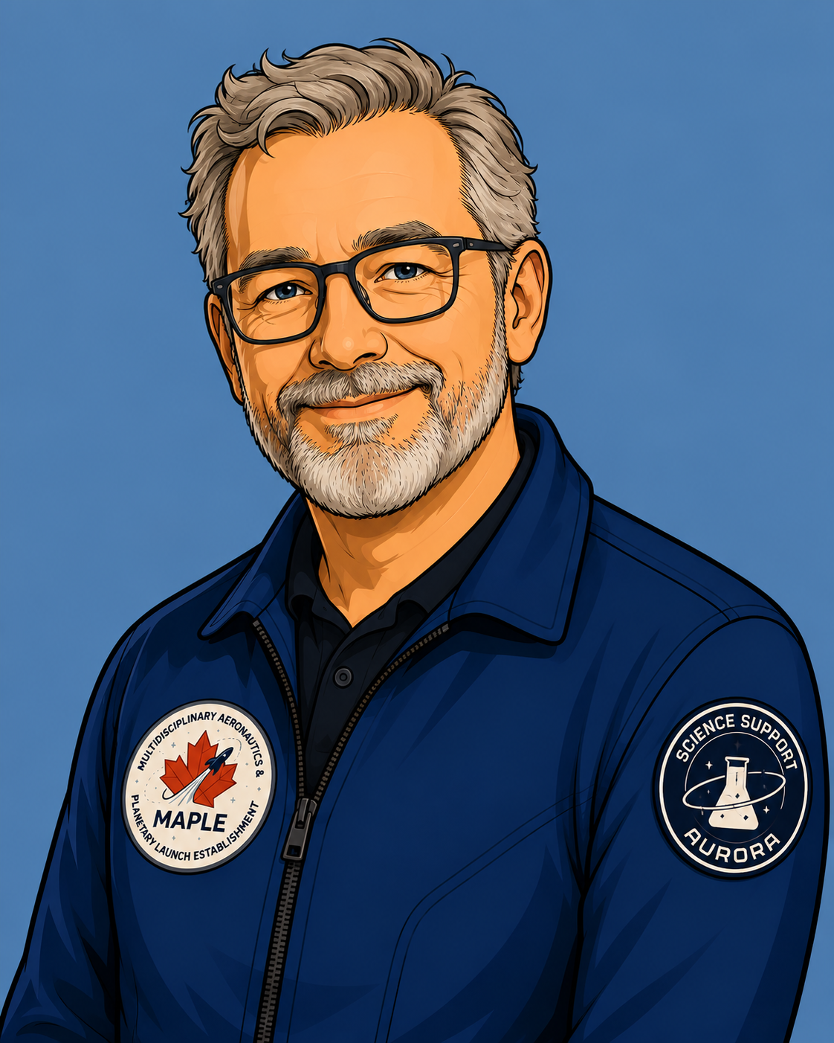
APPLICATIONS
Crew cards need one visual generation
HELENA
SARAH
ALISTAIR — CURRENT
ALISTAIR — LEGACY
USE
USE
USE
ARCHIVE
STANDARDIZE
Use one illustration style, one crop ratio, one data order and one date format across the active crew set.
SPACE STATION AURORA | WORKING VISUAL SYSTEM
10

Slide 11
APPLICATIONS
Staff portraits form a coherent station crew
STAFF PORTRAIT 01
STAFF PORTRAIT 02
STAFF PORTRAIT 03
STAFF PORTRAIT 06
REFERENCE SET
REFERENCE SET
REFERENCE SET
REFERENCE SET
PORTRAIT RULES
Use chest-up illustrated portraits, navy uniforms, muted cool backgrounds and consistent badge placement. The supplied set contains portraits 01-06; shown here are four representative references.
SPACE STATION AURORA | WORKING VISUAL SYSTEM
11

Slide 12
APPLICATIONS
Digital screens should feel like the same station
H.A.R.O.L.D. // COMMUNICATIONS
> SYSTEM DAMAGE DETECTED
> AWAITING RECOVERY CODE
INPUT: ORBIT
COMMUNICATIONS RESTORED
NEXT MODULE AVAILABLE
INTERFACE RULES
• Navy field, white data, orange active state
• Short lines and visible system feedback
• Never advance twice for a repeated code
SPACE STATION AURORA | WORKING VISUAL SYSTEM
12

Slide 13

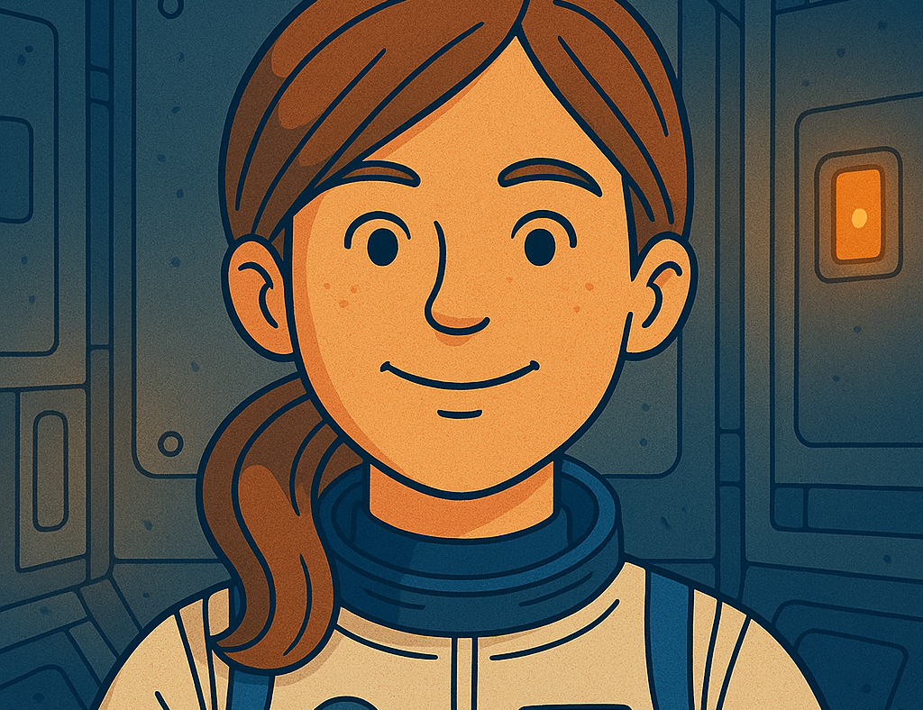
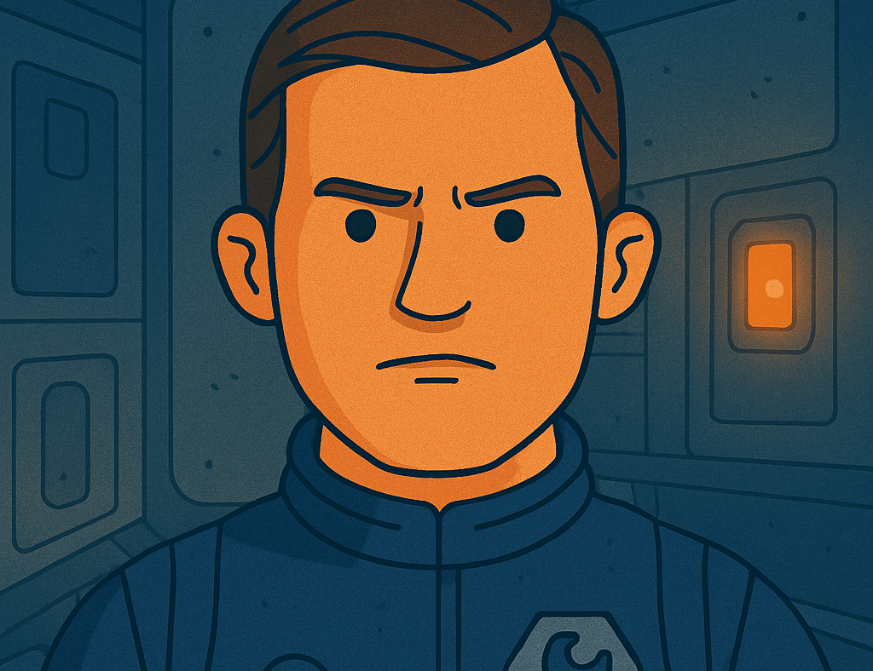
PORTFOLIO
The strongest imagery already shares one world
Environment • technical diagram • crew illustration
SPACE STATION AURORA | WORKING VISUAL SYSTEM
13

Slide 14

PORTFOLIO
The mark library supports both authority and misdirection
AURORA
MAPLE
H.A.R.O.L.D.
E.V.I.L.
B.A.D.
B.A.D. ALT
FISH & NUTS
BETTING
Keep alternates only when they serve a defined clue or production need; otherwise archive them.
SPACE STATION AURORA | WORKING VISUAL SYSTEM
14

Slide 15
GOVERNANCE
The remaining design debt is specific and manageable
PRIORITY
DECISION
CURRENT ISSUE
RESOLUTION
P0
Station patch master
Current file is 102 × 102 px
Create vector/high-resolution master
P0
Crew illustration style
Current and legacy Alistair styles conflict
Choose active style; archive the other
P1
E.V.I.L. typography
Times New Roman and DownCity both appear
Select one corporate treatment
P1
Document templates
Props share ideas but not fixed layouts
Create briefing, evidence and memo masters
P1
Digital UI states
Only part of H.A.R.O.L.D. is implemented
Define five module states and feedback
SPACE STATION AURORA | WORKING VISUAL SYSTEM
15

Slide 16
GOVERNANCE
Use this checklist before releasing any asset
One clear issuer and one clear purpose
Navy and orange used with defined roles
Typography matches the content type
Images belong to the same visual generation
Dates, names, acronyms and codes match canon
If an asset cannot pass every check, label it WORKING—not final.
Print size, contrast and crop have been tested
Source file, export and archive version are named
NEXT: resolve the P0 decisions, then create reusable prop templates.
SPACE STATION AURORA | WORKING VISUAL SYSTEM
16

